Slide 1
Preparing learners for a reformed post-16 qualification landscape and options for reform pre-16
March 2024

Slide 2
CEO Learning Set Purpose and Design
Started looking at the horizon and how the educational landscape needs to respond.
.Seizing the opportunity to respond to the proposal of the ABS – particularly at post 14 but across the age range
North star for the group is ‘curriculum design’
We owe it to our children to ensure that they are prepared to succeed. Do we do that with honesty and determination, or do we let these era-defining changes pass us by and hope we can keep everything the same? No business would look at this challenge and choose to stand still. Neither will we. Because if we are bold and determined about the aspirations we have for our children, we can change lives.
A World-Class Education System - The Advanced British Standard
Notes:
Quite opportune
Responding to the ‘mood music’ in education – topical debates/ position

Slide 3
If we continue down the track of sustaining outdated practices in education, we will continue to churn out a population of students who may be good at “doing school,” but may not be prepared to do well in life.
Eric Sheninger
Disruptive Thinking in Our Classrooms: Preparing Learners
for Their Future

Slide 4
Current landscape
No genuine parity of esteem between technical & academic education.
Technical routes less well understood than traditional educational pathways.
Too many students leave education without a good pass in English and Maths (numeracy and literacy both have strong links to wage returns and are fundamentally integral to connected, engaged, fulfilling lives)
High levels of absence and engagement
Teacher recruitment and retention crisis
.

Slide 5
There comes a point where we need to stop just pulling people out of the river. We need to go upstream and find out why they’re falling in. Desmond Tutu
Notes:
Frame this within the ‘flourishing school’ agenda.
All too frequently looking at the effects – by products of issues
Conversation regarding attendance and mobile phones.

Slide 6
2030 – Most in demand jobs
‘In 2030, 85% of us who are in work will be doing jobs that don’t exist yet (Dell 2023)’
Organ Creator
Augmented – reality journey builder -Metaverse Planner
Biofilm
installer
Earthquake forecaster
Makeshift structure engineer
Algorithm bias auditor
Rewilder
Human – machine teaming manager
Digital currency advisor
Drone traffic optimizer
Autonomous car mechanic
Smart home design manger
Agile Supply chain worker
Trash/waste engineer
'But a child starting school today at the age of five will step into adulthood facing a labour market that is almost unrecognisable’
A World-Class Education System - The Advanced British Standard
Notes:
According to the WEF, more than half of the jobs that we do in 2030 will require an understanding of digital technology. This means that people who are able to effectively use digital tools and platforms to solve problems and create value will be increasingly in demand. I would go as far as saying that those who lack digital literacy will be at a severe disadvantage when it comes to competing for jobs and business opportunities by 2030, whatever career path they decide to follow. – FORBES 2023

Slide 7
“Some of the most in-demand skills of the workplace of the near future will revolve around tackling high- level challenges. Leadership, human judgment, complex decision-making, collaboration and team-working, digital threat awareness, awareness of issues of ethics, culture, and diversity.”
Bernard Marr

Slide 8
Future landscape
Changes to Post-16 potentially a motivating force for changes to pre-16 education.
Already suggestion to reduce the number and/or length of papers that children sit, thereby saving time on exams and marking.
Proposal to adopt digital solutions, such as on screen assessment, which would open up new possibilities and allow us to assess performance in more innovative and less onerous ways.
Reinstating types of courses defunded following the Wolfe Review and adding new courses for the 21st Century – including multi-modal assessment.
Increase career placements, work experience, inter generational project experiences
flexible learning programmes – in person and virtual
Strong emphasis on skill development
Notes:
We need to go much further than simple iterative changes to a Victorian curriculum model – there needs to be a dynamic shift.

Slide 9
Schools education – coherent, unified, holistic – where next?
Focusing apprenticeships on young people for example, by echoing the Scottish foundation apprenticeships model and providing high quality pre-apprenticeship opportunities and Young Apprenticeships from 14.

Slide 10
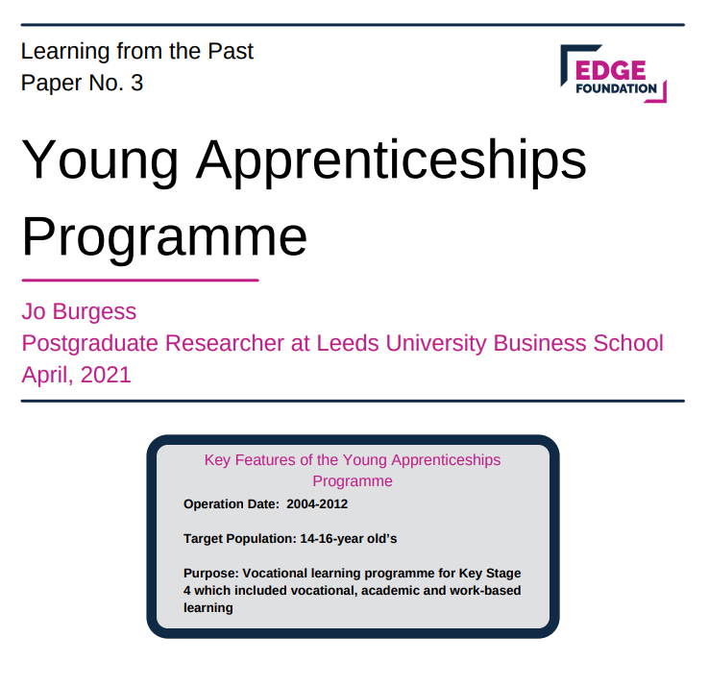
Young apprenticeships programme
Key features
Target population
14-16 year olds
Purpose
Vocational learning programme for Key Stage 4 which includes vocational, academic and work-based learning
Notes:
Currently in Scotland and Wales YA’s are
Specifically designed to complement academic studies – students enrol in a 2yr foundation apprenticeship alongside five other subjects – rendering the academic/vocational divide obsolete.
Involving extended periods of work placement
Apprenticeships spend at least one day per week learning practical skills at a local college or employers that have partnered with their school to deliver the programme
Addressing the issue of falling number of apprenticeship starts for the 16-19 group exacerbated by the pandemic.
Raise awareness in our schools of apprenticeships – increase in apprenticeships and learners to hear from different providers of vocational education and apprenticeships
CPD staff – development of a new teaching degree apprenticeship – raise the profile – critical if teaching staff enter the profession from different routes it will bring a greater awareness

Slide 11
Future landscape
Notes:
Knowledge is a commodity, Google knows everything, AI’s outperform humans in many fields and keep enhancing their capabilities at an unprecedented speed.
The focus of education is shifting towards preparing individuals for success in an AI-dominated future.
By incorporating updated predictors of success that consider Key Success Factors in the age of AI, individuals can effectively navigate the future and find opportunities where human abilities still hold value.
It is for this reason why we need to be developing a curriculum where we are able to ‘robot proof’ our students
Those who will thrive in the upcoming period need to be creative, adaptive and problem-solvers. Education needs to focus on more robust and general meta-learning, namely "the knowledge, skills, and dispositions that support learning and applying knowledge productively". In other words, the education system needs to breed practical learners.
Need to focus on different skills

Slide 12
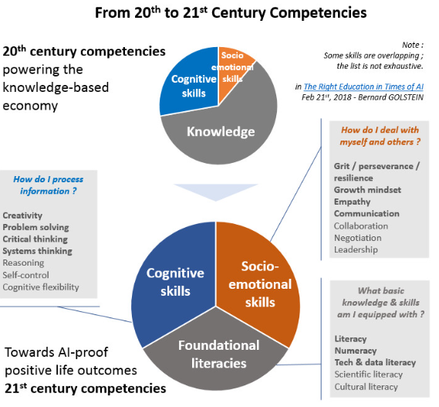

Slide 13
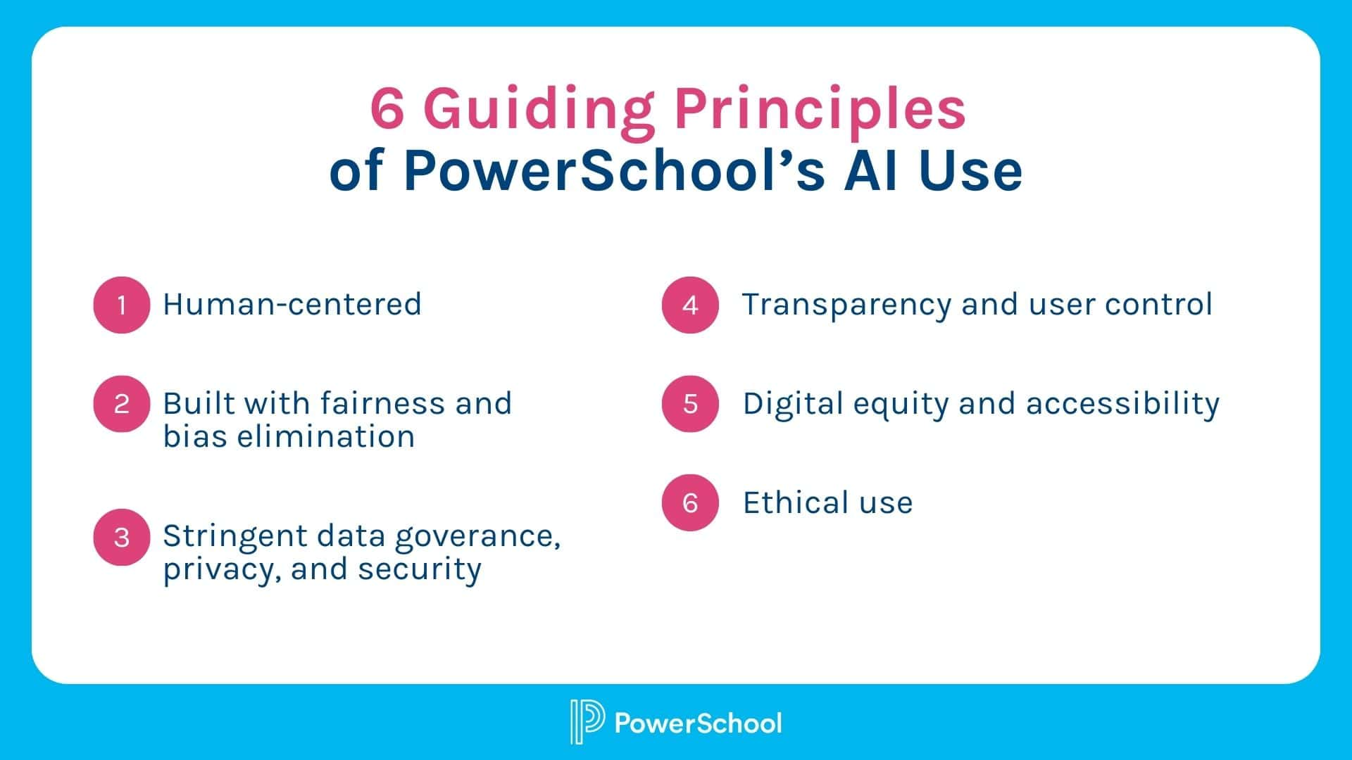
Outcomes of Advanced British Standard
More contact time with specialist teachers
Focus on Skills
Use of careers
Creating new leaders
Project based tasks
Role of placements and work experience
Development of soft skills
Increasing resilience
Change the language around more maths and English
Support a competitive, dynamic economy. This means building a talent pipeline based on the knowledge and technical skills that individuals and employers need, now and in the future. Even when societies and economies change, some education fundamentals remain a strong predictor of success: the ability to understand and work with numbers, to absorb information well, and to communicate powerfully. We must also ensure that our workforce is internationally competitive. We want a labour market that is the envy of the world in its skillset and productivity, and which can drive global innovation.
A World-Class Education System - The Advanced British Standard
Notes:
Our vision for the outcomes of ABS need to be tangible – students need to learn skills that can set them up for the future.
We need to embrace AI in the classrooms as that is what students will be facing in the workplace.
The focus as Post 16 has to be on skills – foundational and fundamental knowledge should already exist from KS4 so KS5 is the application of knowledge to real life situations.
Opportunity to give students a voice and really embrace student leadership – by doing this we will have more resilient happy and healthy young people ready to support the economy.
Utilising and forging partnerships with business in the local communities will help support better work experience opportunities and will potentially open opportunities for apprenticeships and placements.

Slide 14
Notes:
DfE ban of mobile phones

Slide 15
Advanced British Standard Wishlist
HOW CAN WE SATISFY A 21ST CENTURY LEARNER PROFILE?
Ebacc bucket –opportunity for innovation?
Career opportunities
Project based learning
Skills based learning at KS4
Student leadership opportunities
Notes:
Many vocational qualifications that could have gone in the third bucket were defunded and done away with.
Is this an opportunity for us to be creative? Include subjects that are truly vocational and create a segway into ABS?
Career opportunities – more scope for work experience? Industry placements for students and staff (discuss initiative for TST and staff)
PBL
Consider shifts in assessment - Project based learning. The use of PBL resources will start the process of making education relevant, linking education to the real world and developing employer engagement at this early stage. Focussing on those skills we are know are fundamental to success in life, including:
Listening
Speaking
Problem Solving
Creativity
Staying Positive
Aiming High
Leadership
Teamwork
PBL advances educational equity and empowers youth furthest from opportunity.
It is transformative for all students.
Through PBL, students engage in learning that is deep, long-lasting, and relevant to the challenges of their lives and the world they will inherit. Research confirms this.
Assessment to be multi modal – presentations/ written/ product based

Slide 16
Time for change?

Slide 17
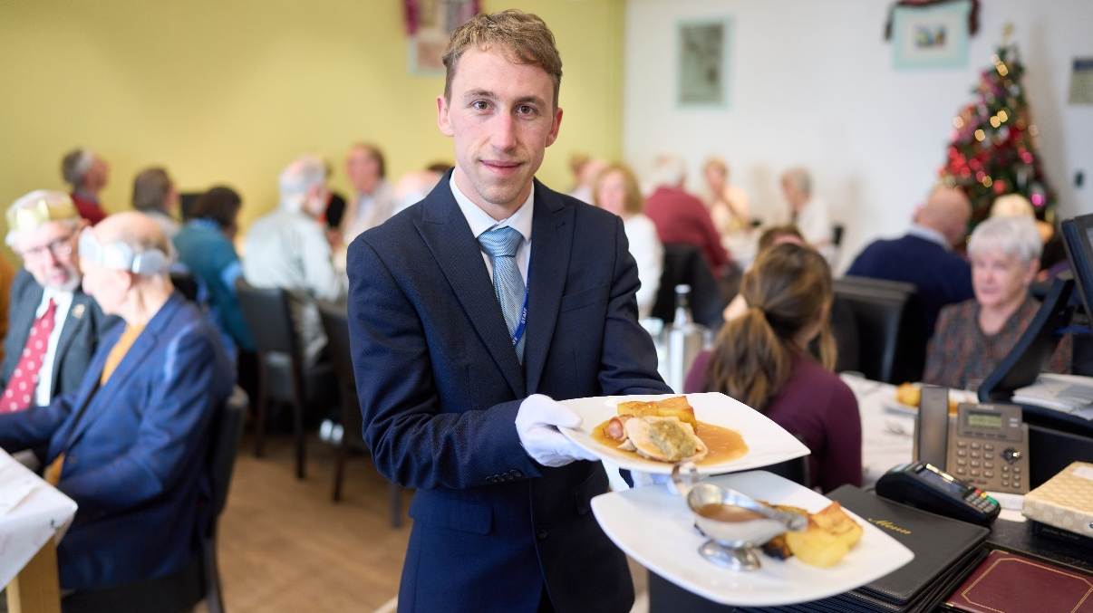
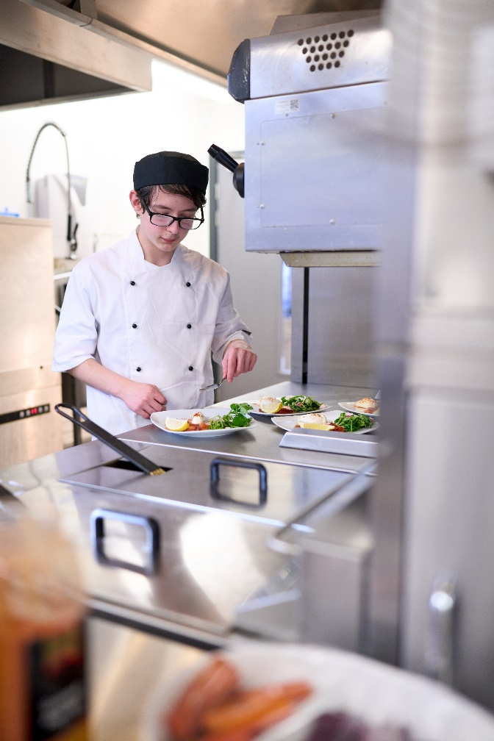
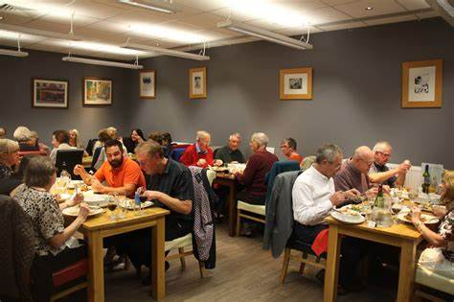
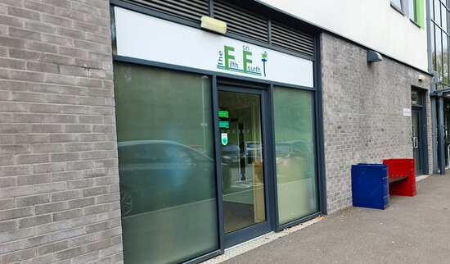
The Fifth on Fourth Bistro
“I tried the posh restaurant where three courses cost less than £12”
Hannah Hiles, The Sentinel, 2023

Slide 18
Basketball Academy

Slide 19
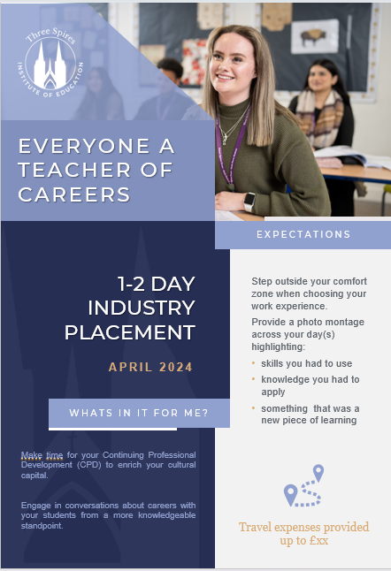
Staff workplace secondment

Slide 20
The trust system was built on the spirit of innovation and making a difference for children and young people, particularly those who find learning more difficult. Let’s recapture this pioneering spirit and create the change we want to see. Leora Cruddas – CST
Notes:
Monday 24th February
Sense of moral imperative
Bold change – courageous advocates for that change

